Slide 1
Project Title - Healthcare Analytics for Doctor Visits _TIRTC​
Name - Shivani Radhakisan Charvande
ID - STU698ee416d64e61770972182

Slide 2


PROBLEM STATEMENT
Healthcare organizations generate large amounts of patient data, including health conditions, illness, income, insurance, and doctor visits. Analysing this data can help identify patterns in healthcare usage.
This project focuses on analysing healthcare data to:
Analyse patient health conditions.
Study doctor visit patterns.
Identify factors affecting doctor visits.
Analyse illness, income, insurance, and chronic conditions.
Visualize healthcare data to generate useful insights.

Slide 3
Project Description
This project focuses on analysing a healthcare dataset containing information about patients and their doctor visits.
The dataset contains 5,190 patient records and 13 variables.
The analysis includes:
Data loading and preprocessing
Dataset exploration
Missing-value analysis
Univariate analysis
Bivariate analysis
Doctor visit analysis
Illness and health analysis
Insurance analysis
Correlation matrix

Slide 4

WHO ARE THE END USERS?
Hospitals and Clinics – to understand patient visit patterns.
Healthcare Analysts – to analyze healthcare data and trends.
Doctors and Healthcare Professionals – to understand patient health patterns.
Healthcare Administrators – to support resource and service planning.
Researchers – to study factors related to healthcare utilization.
Insurance Organizations – to analyze insurance and healthcare-related patterns.

Slide 5

Technology Used
Python – Programming language
Pandas – Data loading, cleaning, and analysis
NumPy – Numerical operations
Matplotlib – Data visualization
Seaborn – Statistical graphs and heatmaps
Google Colab – Development and execution platform
CSV Dataset – Healthcare patient data source

Slide 6
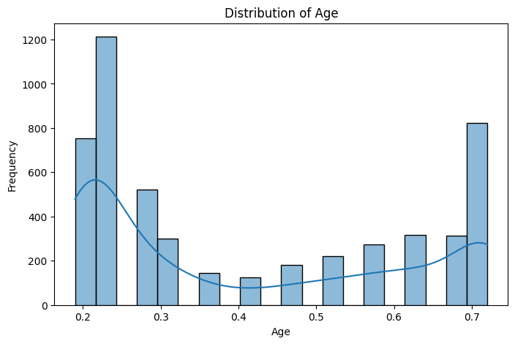
RESULTS
Github Link

Slide 7
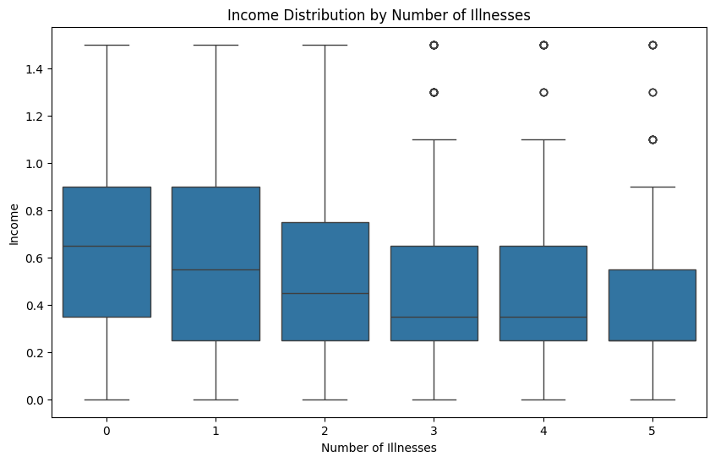

Slide 8
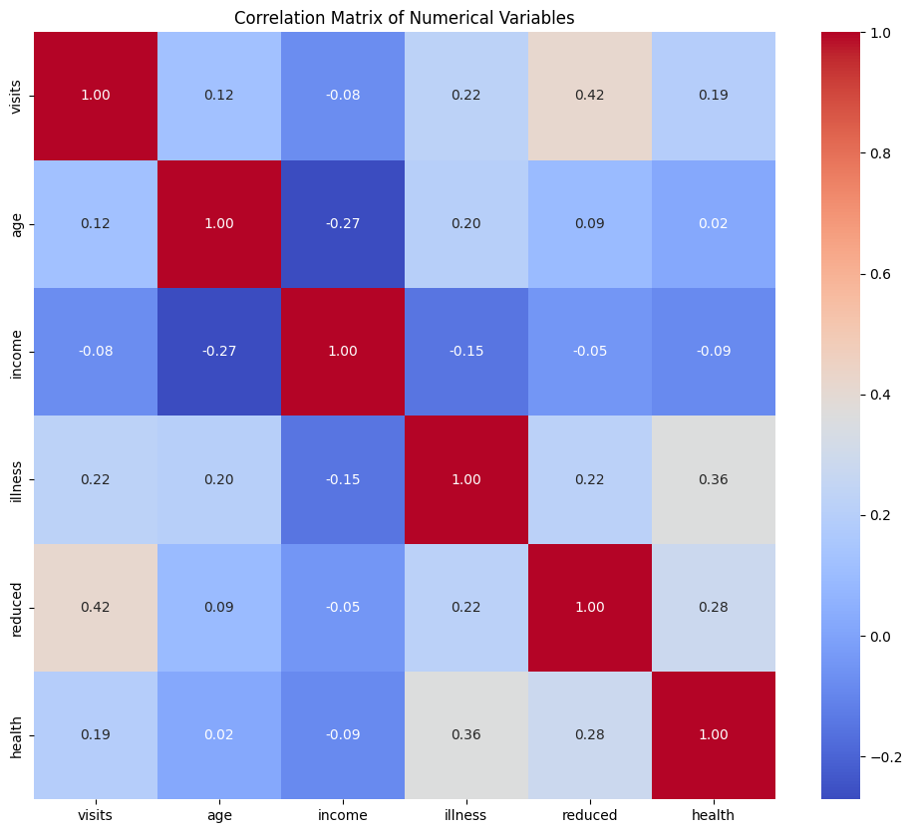

Slide 9
Thank you
.
.

